Slide 1
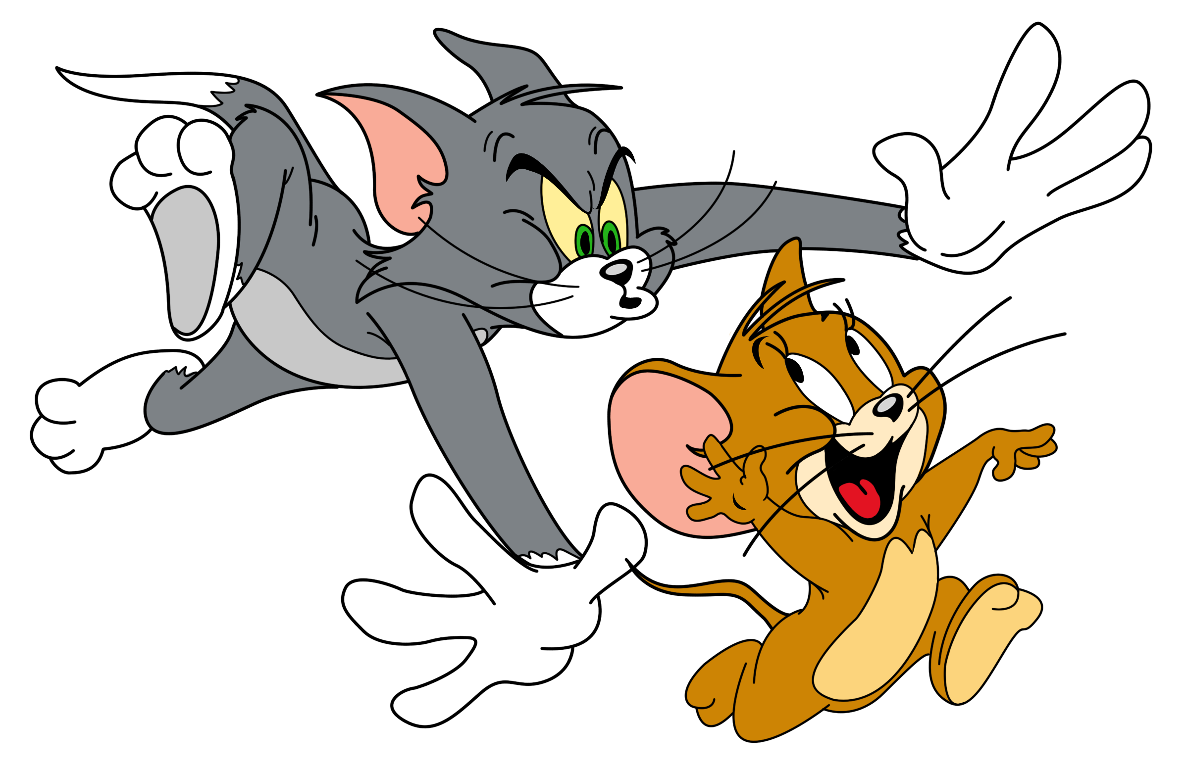
TeamAngio Tablut
Jasmin De Cecco
Matteo Di Lorenzi
Lorenzo Magnanelli
Mattia Mazzoli THE LEGEND

Slide 2
Brief Description
Smart agent built to play Tablut with Ashton rules.
Bitboards: an efficient way to describe the state of the game.
Monte Carlo Tree Search (without the neural network part ☹).
Multithreading: tree parallelization allow us to takes full advantage of the available cores.

Slide 3
Languages
Python
Handle communication with server.
Convert java board into our state representation and viceversa.
Trigger state space search.
C
Efficient representation of the board.
Compute the possible legal moves.

Slide 4
Bitboards
Inspired by Chess engines.
Bitboard as an array of three 32 bit integers.
Constant bitboards for castle, citadels and escape tiles.
Board as three bitboards: king, white and black pawns.
Implementation of bitwise operation and moves computation.
0 | 1 | 0 | 0 | 0 | 0 | 1 | 1 | 0
1 | 1 | 0 | 1 | 0 | 0 | 0 | 0 | 1
1 | 0 | 0 | 1 | 0 | 1 | 0 | 1 | 1
1 | 0 | 0 | 1 | 1 | 0 | 1 | 1 | 0
0 | 0 | 0 | 1 | 0 | 1 | 1 | 0 | 1
1 | 1 | 0 | 0 | 1 | 1 | 0 | 1 | 0
0 | 1 | 0 | 1 | 0 | 1 | 0 | 0 | 1
0 | 0 | 1 | 1 | 0 | 1 | 0 | 0 | 1
0 | 1 | 1 | 0 | 0 | 1 | 1 | 1 | 0
01000011 01101000 01100101 01110011
01100001 01101110 01101001 01010010
01101001 01100111 01101000 01110100

Slide 5
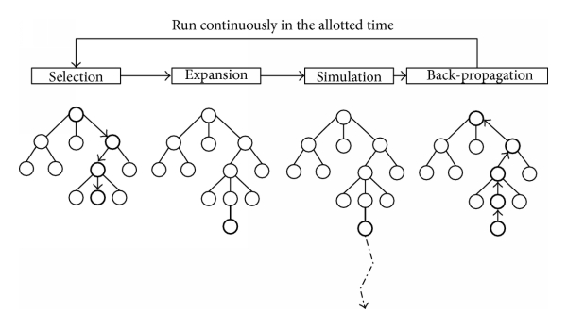
Monte Carlo Tree Search
Inspired by AlphaZero.
Monte Carlo consists in:
Selecting: select the node that has the highest possibility of winning;
Expanding: node expantion from the selected one;
Simulating: play a game of completely random decisions until it reaches a terminal state (win, lose, draw or simulation cap reached) and return a score of how well it performed;
Updating: propagate the results through the tree.

Slide 6
Heuristic & Multithreading
Simple heuristic.
Same for both black and white.
a) count of how many times the node n is visited.
b) count of how many times win condition is reached passing through node n.
Heuristic: b/a. The higer the better.
Tree parallelization in order to perform MTCS on every available core.
At the end of a search we collect the trees and return the best move among all of them.

Slide 7
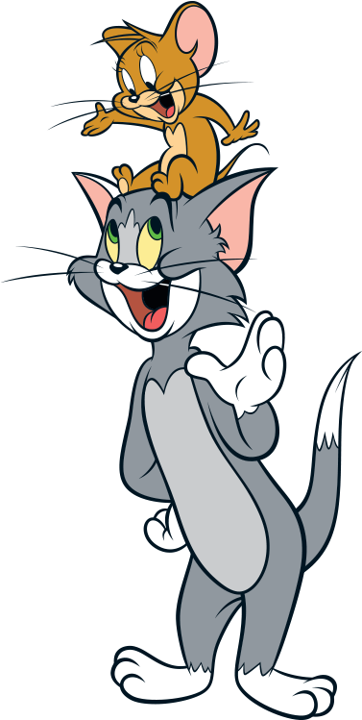
Thank You!

